Slide 1
Cornell Note-taking & Building Memory
Cornell Note-taking Method, Storing Data, Representing and Building Memory, Program Counter Overview

Slide 2
Lecture Outline
Cornell Note-taking Method
  System for Taking, Organizing, and Reviewing Notes
Review of Sequential Logic and DFFs
Storing Data: Bit
  Bit Overview and Implementation
Representing and Building Memory
  Array Abstraction, Building From the Bit
Program Counter (PC) Overview
  Control Flow of Computer Programs

Slide 3
Recap: Bloom’s Taxonomy
Creating
Producing something new
Justifying your decisions or position
Evaluating
Drawing connections among ideas
Analyzing
Using information in a new (or similar) situation
Applying
Understanding
Explaining ideas or concepts
Remembering
Recalling facts and basic concepts

Slide 4
Cornell Note Taking Method
Questions
Notes
Main Topic
  Sub point
  definition
  example **
Object-Oriented Programming
  Encapsulates the data and the operations for a given data type
  Provides abstractions - you don’t need to know how a car is implemented in order to use it
  Extensibility - easier to add new data types
Functional Programming
  Extensibility - easier to add new operations
Compose a question that corresponds to the notes you took
In what ways is object-oriented programming more extensible than functional programming?
Summary
Object-oriented programming and functional programming are two types of programming paradigms…

Slide 5
Cornell Note Taking Method
Questions
Notes
Main Topic
  Sub point
  definition
  example **
Object-Oriented Programming
  Encapsulates the data and the operations for a given data type
  Provides abstractions - you don’t need to know how a car is implemented in order to use it
  Extensibility - easier to add new data types
Functional Programming
  Extensibility - easier to add new operations
Compose a question that corresponds to the notes you took
In what ways is object-oriented programming more extensible than functional programming?
Summary
Object-oriented programming and functional programming are two types of programming paradigms…

Slide 6
Applying the Cornell Note-Taking Method
Try it during today’s technical lecture!
Next week, we’ll provide you with an opportunity to discuss your notes with your classmates
You will also practice it with one of your other classes as part of Project 4

Slide 7
Lecture Outline
Cornell Note-taking Method
  System for Taking, Organizing, and Reviewing Notes
Review of Sequential Logic and DFFs
Storing Data: Bit
  Bit Overview and Implementation
Representing and Building Memory
  Array Abstraction, Building From the Bit
Program Counter (PC) Overview
  Control Flow of Computer Programs

Slide 8
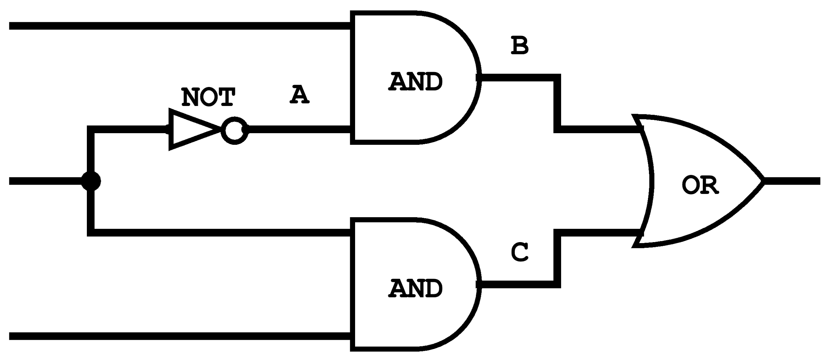
Describe the behavior of the Autopilot Engaged (AE) output between 1ms to 6ms.
Copilot Autopilot Request
Pilot Flying?
Autopilot Engaged
Pilot Autopilot Request
CAR | 1 | 1 | 1 | 1 | 1 | 1
PF | 1 | 0 | 0 | 0 | 0 | 0
PAR | 1 | 1 | 1 | 1 | 1 | 1
A | 0 | 0 | 1 | 1 | 1 | 1
B | 0 | 0 | 0 | 1 | 1 | 1
C | 1 | 1 | 0 | 0 | 0 | 0
AE | 1 | 1 | 1 | 0 | 1 | 1
!
0ms
1ms
2ms
3ms
4ms
5ms
6ms

Slide 9
Autopilot Control Circuit Example
Copilot Autopilot Request
Critical Path
Pilot Flying?
Autopilot Engaged
Pilot Autopilot Request
CAR | 1 | 1 | 1 | 1 | 1 | 1
PF | 1 | 0 | 0 | 0 | 0 | 0
PAR | 1 | 1 | 1 | 1 | 1 | 1
A | 0 | 0 | 1 | 1 | 1 | 1
B | 0 | 0 | 0 | 1 | 1 | 1
C | 1 | 1 | 0 | 0 | 0 | 0
AE | 1 | 1 | 1 | 0 | 1 | 1
!
0ms
1ms
2ms
3ms
4ms
5ms
6ms

Slide 10
Physical Timekeeping
Hardware keeps track of time using an alternating signal
  Creates the idea of discrete time: state changes only occur in discrete intervals, right when signal alternates
Physical Time
Clock Signal
1
0
t=0
t=1
t=2
t=3
t=4
Discrete Time Intervals

Slide 11
Adding a Clock: Clock Cycles
Choose a clock cycle length slightly longer than the delay length of the critical path
> 3ms
Clock Signal
1
0
1
in
0
1
out
0
t=0
t=1
t=2
t=3
t=4

Slide 12
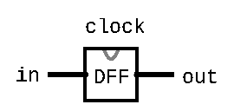
The Data Flip-Flop Gate
Simplest state-keeping component
  1-bit input, 1-bit output
  Wired to the clock signal
  Always outputs its previous input: out(t) = in(t-1)
Implementation: a gate that can flip between two stable states (remembering 0 vs. remembering 1)
  Gates with this behavior are “Data Flip Flops” (DFFs)

Slide 13
Data Flip-Flop (DFF) Behavior
1
Clock Signal
0
1
in
0
out
1
0
t=0
t=1
t=2
t=3
t=4

Slide 14
Sequential Chips
output(t) = f(state(t-1), input(t))
DFF
Combinational Logic
f
input
DFF
output
DFF

Slide 15
D Flip-Flop: Time Series
DFF Specification:
out(t) = in(t-1)
in | 0 | 0 | 1 | 1 | 0 | 1 | 0 | ...
out | 0 | 0 | 0 | 1 | 1 | 0 | 1 | ...
time | t=0 | t=1 | t=2 | t=3 | t=4 | t=5 | t=6 | ...
Example: out(t=3) = in(t=2)

Slide 16
DFF Example 1: Specification
Example specification:
out(t) = Xor(a(t-1), b(t-1))
Takes two inputs, a and b, and outputs the Xor of them
  Note that out at time t is determined by a and b at time t-1
  We will need to use a DFF
Exercise: Draw out the corresponding circuit diagram and HDL implementation

Slide 17
DFF Example 1: Time Series
Example specification:
out(t) = Xor(a(t-1), b(t-1))
Example: out(t=3) = Xor(a(t=2), b(t=2))
a | 0 | 0 | 1 | 1 | 1 | 0 | 0 | ...
b | 0 | 1 | 0 | 1 | 1 | 1 | 0 | ...
out | 0 | 0 | 1 | 1 | 0 | 0 | 1 | ...
time | t=0 | t=1 | t=2 | t=3 | t=4 | t=5 | t=6 | ...

Slide 18
DFF Example 1: Circuit Diagram & HDL
Example specification:
out(t) = Xor(a(t-1), b(t-1))
Circuit diagram:
HDL:

Slide 19
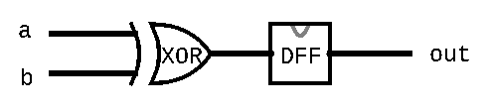
DFF Example 1: Circuit Diagram & HDL
Example specification:
out(t) = Xor(a(t-1), b(t-1))
Circuit diagram:
HDL:
CHIP Example1 {
IN a, b;
OUT out;
PARTS:
Xor(a=a, b=b, out=xorout);
DFF(in=xorout, out=out);
}

Slide 20
Lecture Outline
Cornell Note-taking Method
  System for Taking, Organizing, and Reviewing Notes
Review of Sequential Logic and DFFs
Storing Data: Bit
  Bit Overview and Implementation
Representing and Building Memory
  Array Abstraction, Building From the Bit
Program Counter (PC) Overview
  Control Flow of Computer Programs

Slide 21
Computer Overview
CPU is the “brain” of our computer
  Does necessary computations (add, subtract, multiply, etc.)
Memory is used to store values for later use
  Requires persistence across multiple computations
  Needs to change values at our discretion
COMPUTER
MEMORY
Data and instructions
CPU
Program Counter (which line of code should I execute)

Slide 22
Storing Data: Bit
A Flip-Flop changes state every clock cycle
We will build the abstraction of a “Bit” that only changes when we instruct it to
load
Bit
in
out
if load(t-1) out(t) = in(t-1)
else out(t) = out(t-1)

Slide 23
Bit Behavior
1
load
0
1
in
0
out
1
0
t=0
t=1
t=2
t=3
t=4
load
if load(t-1) out(t) = in(t-1)
else out(t) = out(t-1)
Bit
out
in

Slide 24
Bit Behavior
1
load
0
1
in
0
out
1
0
t=0
t=1
t=2
t=3
t=4
load
if load(t-1) out(t) = in(t-1)
else out(t) = out(t-1)
Bit
out
in

Slide 25
Bit Time Series
if (load(t-1)): out(t) = in(t-1)
else: out(t) = out(t-1)
Bit Specification:
Example 1: load(t=0) == 1 so out(t=1) = in(t=0)
load | 1 | 0 | 0 | 1 | 1 | 1 | 0 | ...
in | 1 | 0 | 0 | 0 | 1 | 0 | 1 | ...
out | 0 | 1 | 1 | 1 | 0 | 1 | 0 | ...
time | t=0 | t=1 | t=2 | t=3 | t=4 | t=5 | t=6 | ...

Slide 26
Bit Time Series
if (load(t-1)): out(t) = in(t-1)
else: out(t) = out(t-1)
Bit Specification:
Example 1: load(t=0) == 1, so out(t=1) = in(t=0)
Example 2: load(t=2) == 0, so out(t=3) = out(t=2)
load | 1 | 0 | 0 | 1 | 1 | 1 | 0 | ...
in | 1 | 0 | 0 | 0 | 1 | 0 | 1 | ...
out | 0 | 1 | 1 | 1 | 0 | 1 | 0 | ...
time | t=0 | t=1 | t=2 | t=3 | t=4 | t=5 | t=6 | ...

Slide 27
Which gates will we need to implement a Bit? Select all that apply.
Mux
Xor
And
DFF
We’re lost…
load
Bit
out
in
if load(t-1) out(t) = in(t-1)
else out(t) = out(t-1)

Slide 28
Implementing a Bit
if load(t-1) out(t) = in(t-1)
else out(t) = out(t-1)
Bit Specification:
Exercise: fill in the connections to the gates to create a circuit diagram of Bit

Slide 29
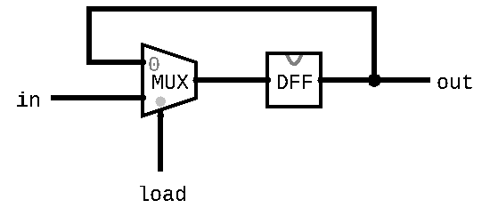
Implementing a Bit
if load(t-1) out(t) = in(t-1)
else out(t) = out(t-1)
Bit Specification:
Exercise: fill in the connections to the gates to create a circuit diagram of Bit

Slide 30

Five-minute Break!
Feel free to stand up, stretch, use the restroom, drink some water, review your notes, or ask questions
We’ll be back at:

Slide 31
Lecture Outline
Cornell Note-taking Method
  System for Taking, Organizing, and Reviewing Notes
Review of Sequential Logic and DFFs
Storing Data: Bit
  Bit Overview and Implementation
Representing and Building Memory
  Array Abstraction, Building From the Bit
Program Counter (PC) Overview
  Control Flow of Computer Programs

Slide 32
Memory Representation
Memory can be abstracted as one huge array
Addresses are indices into different memory slots
  The width of an address is fixed for the system
  The nand2tetris project will use 16-bit addresses
Each value in memory takes up a fixed width
  Not the same as address width
  The nand2tetris project uses 16-bit slots (values) in memory

Slide 33
Memory Representation
Can read and write to memory by specifying an address
  More details next week
Example: x = memory[01...00]
  Reads the value in memory at address 01...00 and stores it in x
Example: memory[01...00] = 7
  Writes the value 7 in the memory slot at address 01...00

Slide 34
Building Memory: Register
Bits store a single value (0 or 1)
  In memory, we need to store 16-bit values
Registers are conceptually the same as a Bit
  Allows us to store and change 16-bit values
  Groups together 16 individual bits that share a load signal
// if (load(t-1)): out(t) = in(t-1)
// else: out(t) = out(t-1)
CHIP Register {
IN in[16], load;
OUT out[16];
...
}

Slide 35
RAM: Random Access Memory
Abstraction of Computer Memory: just a giant array
Goal: create hardware that can provide that abstraction
Key attribute of arrays: “random access” lets us index into them at any point
24 11000 | 25 11001 | 26 11010 | 27 11011 | 28 11100 | 29 11101 | 30 11110 | 31 11111
...
0 0000000 | 0 0000000 | -1 1111111 | 25 0011001 | 124 1111100 | 0 0000000 | 9 0001001 | -15 1110001
...
memory[26] = -1;

Slide 36
Building Memory: RAM8 From Registers
RAM interface:
  address: address used to specify memory slot
  in: 16-bit input used to update specified memory slot if load is 1
  load: if 1, then in should be written to specified memory slot
  out: 16-bit output from the slot specified by address
RAM8 can be built from 8 registers
  address width is log₂(8) = 3 bits
load
RAM8
in
out
0
Register
16
16
1
Register
address
...
n-1
Register
k

Slide 37
Building Memory: RAM8 From Registers
Step 1: Route in to every register
  We don’t want to update every register, however
  Solution: choose which register to enable with address
Step 2: Choose which register to use for the output
When we think about making choices in hardware, we want to think about Mux and DMux
load
RAM8
in
out
0
Register
16
16
1
Register
address
...
n-1
Register
k

Slide 38
Building Memory: The Rest of RAM
After RAM8, can build larger RAM chips from a combination of smaller RAM chips
  For example, RAM64 can be built using eight RAM8 chips
Technique is similar to RAM8 but will have to use different portions of the address
The blocks section of the reading will be helpful
  For example, can think of each RAM8 as a block of RAM64

Slide 39
Lecture Outline
Cornell Note-taking Method
  System for Taking, Organizing, and Reviewing Notes
Review of Sequential Logic and DFFs
Storing Data: Bit
  Bit Overview and Implementation
Representing and Building Memory
  Array Abstraction, Building From the Bit
Program Counter (PC) Overview
  Control Flow of Computer Programs

Slide 40
Program Counter (PC)
Memory is used to store data as well as code
Instructions and operations are stored at different addresses in memory
Program Counter in the CPU keeps track of which address contains the instruction that should be executed next
COMPUTER
MEMORY
Data and instructions
CPU
Program Counter (which line of code should I execute)

Slide 41
Program Counter (PC)
Keeps track of what instruction we are executing
  If the PC outputs 24, on the next clock cycle the computer runs the instruction at address 24 in the code segment
Program counter specification:
if (reset[t] == 1) out[t+1] = 0
else if (load[t] == 1) out[t+1] = in[t]
else if (inc[t] == 1) out[t+1] = out[t] + 1
else out[t+1] = out[t]
load
inc
reset
in
PC
out
16
16

Slide 42
Project 4 Overview
Part I: Cornell Note Taking
  Practice taking detailed notes in another class
  Think critically about the technique
Part II: Building Memory
  Memory & Sequential Logic: Build our first sequential chips, from a 1-bit register to a 16K RAM module
  Program Counter: Build counter that tracks where we are in a program, with support for several operations we’ll need later
  Note: Folder split for performance reasons only
Part III: Project 4 Reflection

Slide 43
Post-Lecture 7 Reminders
Project 3 due tonight (10/20) at 11:59pm
Project 4 (Cornell Note Taking & Building Memory) released today, due next Thursday (10/27) at 11:59pm
Course Staff Support
  Eric has office hours in CSE2 153 today after lecture
  Post your questions on the Ed discussion board

